Slide 1
FINGER PRINT BASED EXAM HALL AUTHENTICATION
PRESENTED By :
Dhanusya.S(22AI012)
Prassannaa.S.M(22AI038)
Rohini.R(22AI042)
Guided By :
TEAM NO: 11
22AIC14 : Internet of Things & It’s Application

Slide 2
Abstract
A finger print-based exam hall authentication system enhances security by verifying students'
identities through biometric fingerprint scanning. This system eliminates the risks of
impersonation, improves accuracy, and streamlines the authentication process in
educational institutions, ensuring only authorized students access the exam hall.
The proposed system consists of a fingerprint sensor integrated with a database that stores the
biometric data of registered students. During authentication, the fingerprint sensor captures the
student's fingerprint, compares it with the pre-stored data in the database, and grants or denies
access based on the match.

Slide 3
Objectives:
1.)Enhance Security: To prevent unauthorized individuals from entering the exam hall and to
eliminate the risk of impersonation by using biometric fingerprint authentication.
2.)Ensure Accurate Identification: To provide a reliable and precise method of verifying student
identities, reducing the chances of errors compared to manual checks like ID cards or exam passes.
3.)Reduce Paperwork and Forgery: To eliminate the need for physical documents like admit cards
that can be lost, damaged, or forged, ensuring a more secure and digital approach.
4.)Improve Record Keeping: To maintain a secure, digital log of students’ entry into exam halls,
ensuring accurate attendance records for future reference

Slide 4
Components Required:
HARDWARE SPECIFICATIONS:
Atmega Microcontroller
R305 Fingerprint Sensor
Crystal Oscillator
Resistors
Capacitors
Transistors
Cables and Connectors
Diodes
PCB and Breadboards
LED
Transformer/Adapter
Push Buttons
Switch
IC
IC sockets
Small door
SOFTWARE SPECIFICATIONS:
Arduino compiler
C programming lanuguage

Slide 5
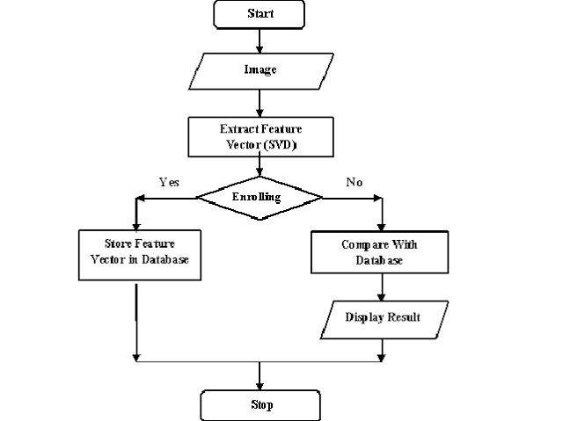
Flow Diagram:

Slide 6
Implementation: (Hardware or Software)
Hardware:
Microcontroller:
Atmega microcontroller
Sensor:
R305 Fingerprint sensor
Capacitors, Transistors, Switch
Push buttons
LED for information display
Software:
Complier:
Arduino complier
Language: C programming

Slide 7
Thank u slide
THANK YOU

